Slide 1
Cities Recommender Mark Valentino
The goal of this project is to recommend cities and towns to individuals based on a city or town's "safety", and "economy". Many people often relocate to new cities that they think are better than the ones they already live in. Determining which city to move to is challenging. Cities that are both safe and economical are ideal but finding an ideal city to move to is hard to determine.
This AI can solve the issue by showing the best cities it finds via Pareto optimization, where cities shown are optimized between "safety" and "economy". First, to keep terminology simple, a "city" can also be a town, "safety" is referred to as a city's population divided by total numbers of crime committed, and "economy" is referred to as a city's median income divided by its cost of living. Higher values for safety and economy are better. Pareto optimization in this case involves making a virtual plot of cities, where cities with the lowest distance from the plot origin are the best cities.

Slide 2
In order to determine where cities are plotted, the values of their "safety" and "economy" are ranked in descending order, with the value '0' being the top possible rank. Plotted cities have their distance from the origin calculated, which is referred to as "magnitude", and lower magnitudes are better. Magnitudes then indicate how good a city is overall with its safety and economy values. The lower the magnitude, the more Pareto efficient a city is. Magnitudes can then be sorted in descending order, leaving the best cities at the top and the worst at the bottom.
Naturally as this sorted list is iterated through, many cities will start to increasingly skew more and more either to being more safe or more economical. Users most likely would have a preference of having a safer city or a more economical city, but users probably would not like to live in a city that is very safe with a bad economy or vice versa. This magnitude sorted list of cities can then be divided into two categories, one that skews safer, one that skews economical. These categories will still be sorted in terms of balance between safety and economy. Two cities from both categories can be shown to the user.

Slide 3
Datasets used are from the sources as follows:
Cost of Living of Cities: https://advisorsmith.com/data/coli/
Median Income of Cities: https://www.census.gov/data/datasets.html
Crime and Population of Cities: https://ucr.fbi.gov/crime-in-the-u.s/2010/crime-in-the-u.s.-2010/tables/10tbl08.xls/view
Cost of Living of States: https://meric.mo.gov/data/cost-living-data-series

Slide 4
In order to determine how good or bad cities are, data from the datasets on the previous slide were first combined into one dataset. To help with combining data, inconsistent naming practices were dealt with, such as the state of Alabama being listed as both "AL" and "ALABAMA" in different datasets. Another example is that Honolulu was listed as both "Urban Honolulu" and just "Honolulu". The selection of cities in the census dataset were chosen as the main selection of cities since the census dataset was in the middle in terms of how many cities it covered. There were cities from the FBI crime dataset and the Advisorsmith dataset that were left over in that they could not be applied to cities from the census dataset. The dataset of cities with combined data had nearly 4,000 cities.

Slide 5
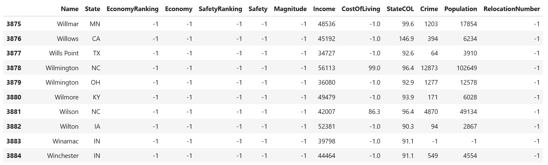
Tail of combined results into one dataframe:
Most missing values were for the city COL. Some were for crime and population. If a city had no crime value, it had no population value, since one dataset had values on crime and population.

Slide 6
The combined results only had about 500 cities with no missing data. Better recommendations could be made if there were even more cities with no missing data, so datatypes on the cities were analyzed to see if there were correlations between them in hopes of being able to accurately impute data.

Slide 7
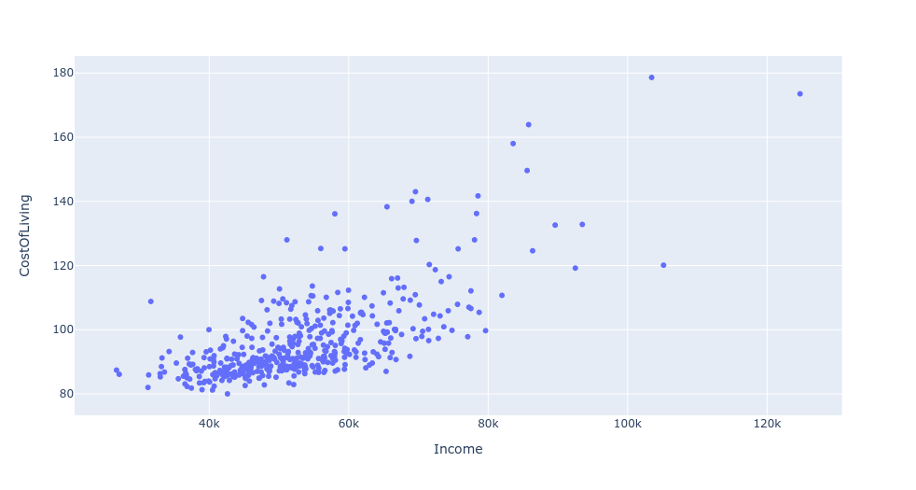
It was found that there was a correlation between COL and income:

Slide 8
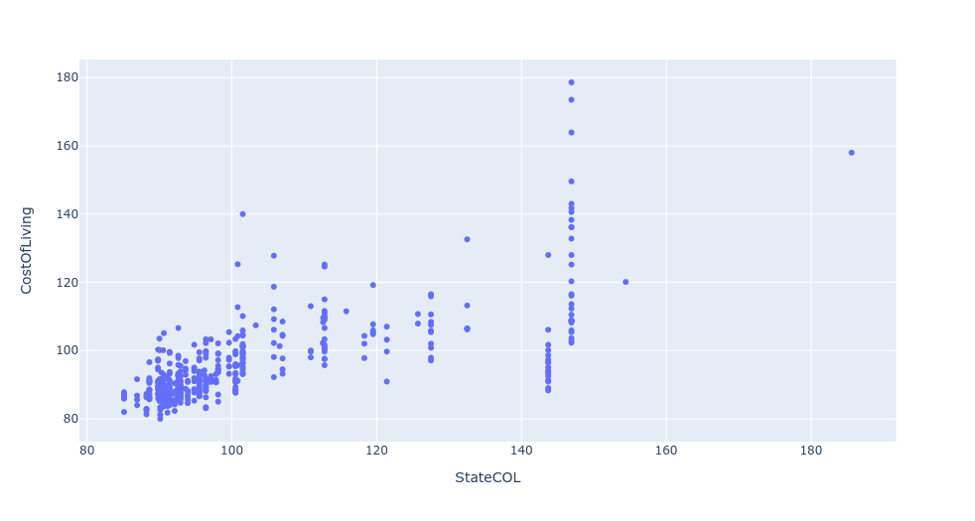
State COL and city COL were found to be related:
Population, crime, and safety did not show strong enough correlations with COL.

Slide 9
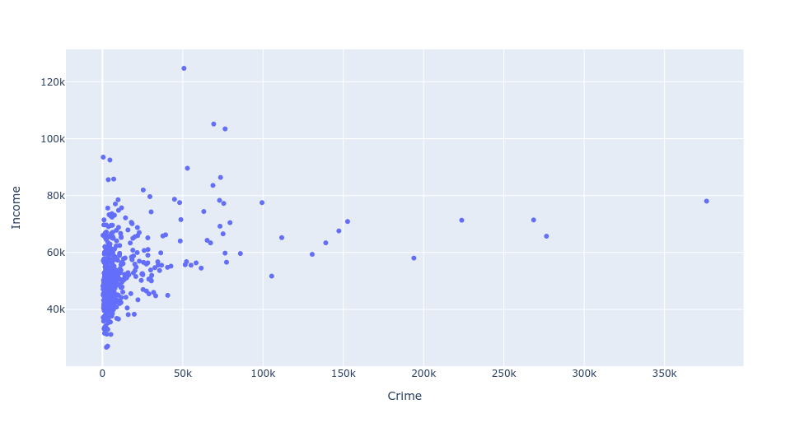
There was not a good correlation for crime and income:

Slide 10
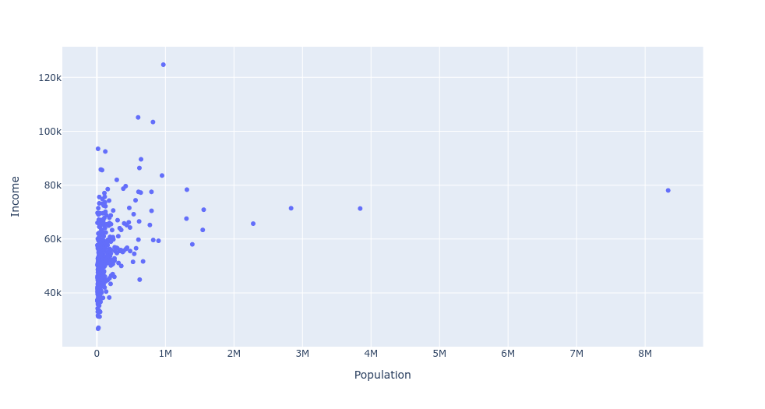
There was not a good correlation for income and population:
Crime and population would not have been able to have been imputed accurately enough.

Slide 11
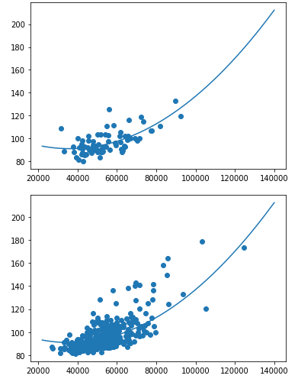
A machine learning function was generated which was trained on both income and COL for cities with no missing data in those categories.
The machine learning function was found to be off by 6.44 points on average.
A test was done on how accurate just the values of a city’s state COL compare to actual COL and was found to be off by 8.86 points on average.
It was found that if the ML predicted function and state COL were combined in a 70/30 ratio, accuracy increased to being 5.28 points off on average.
ML predicted * 0.70 + state COL * 0.30

Slide 12
It was then found that accuracy could be increased further. Cities were divided up into two categories. One with median income <= the US median income (62843) and cities >= the US median income.
It was found that the 70/30 ratio was still the best for lower income cities, and accuracy was off 4.78 points off on average.
For higher income cities, a 40/60 ratio was the best with accuracy at 6.67 points off on average. ML predicted * 0.40 + state COL * 0.60
Higher income cities were contributing to lower accuracy before the cities were dived up.

Slide 13
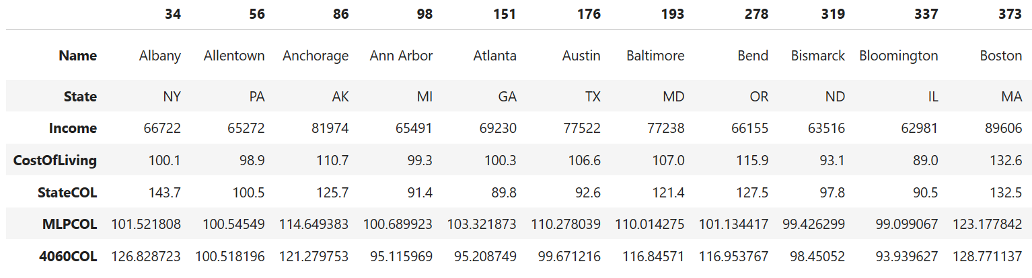
Accuracies of higher income cities:

Slide 14
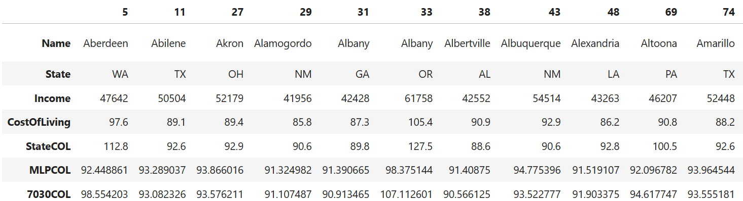
Accuracies of lower income cities:
It was decided that these predicted COLs were not accurate enough to rank cities for recommendation but would be useful in giving users the option to compare their own city with a top ranked city to see if it is worth getting a recommendation for a city.

Slide 15
Safety and economy were calculated for all cities. Then, rankings in economy and safety were calculated. How many people could relocate to the cities without overloading a city’s economy was estimated based off of how many open apartments Manhattan had and Manhattan's total population. That figure was then cut in half to be safe. Magnitude (distance from origin) was finally calculated. Cities were then sorted by magnitude with the best cities on top. If COL was estimated for a city, it was flagged.
To see if the results were sensible, some googling of the cities were done.
It was interesting to note that cities that were lowest on the list had a bad reputation on sites like Reddit. Cities highest on the list appeared to have favorable reputations, except for complaints like there being “no night life”.

Slide 16
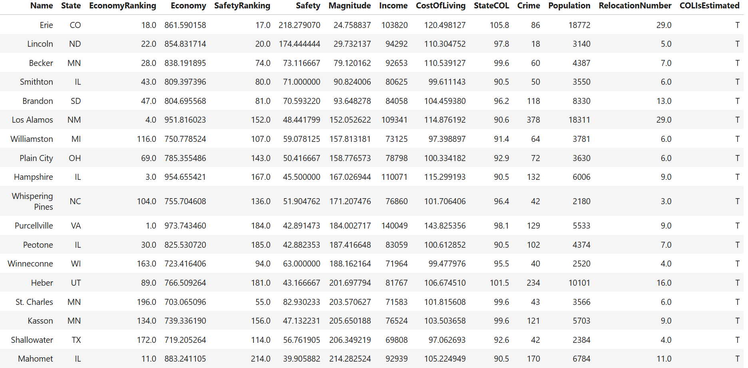

Slide 17

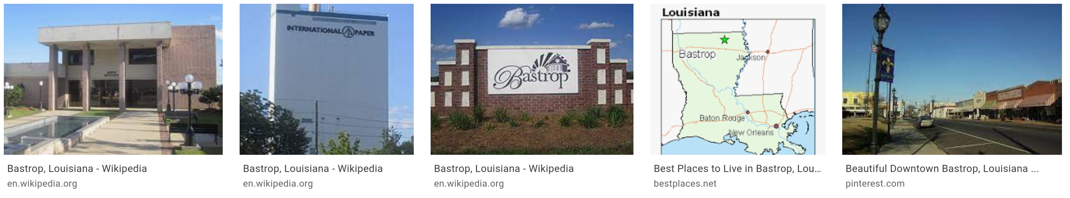
Comparing the two image search results, you get the impression that Erie is a nicer city than Bastrop.
Some quick research on Bastrop showed that Bastrop's economy has been severely affected by a paper mill closing.

Slide 18
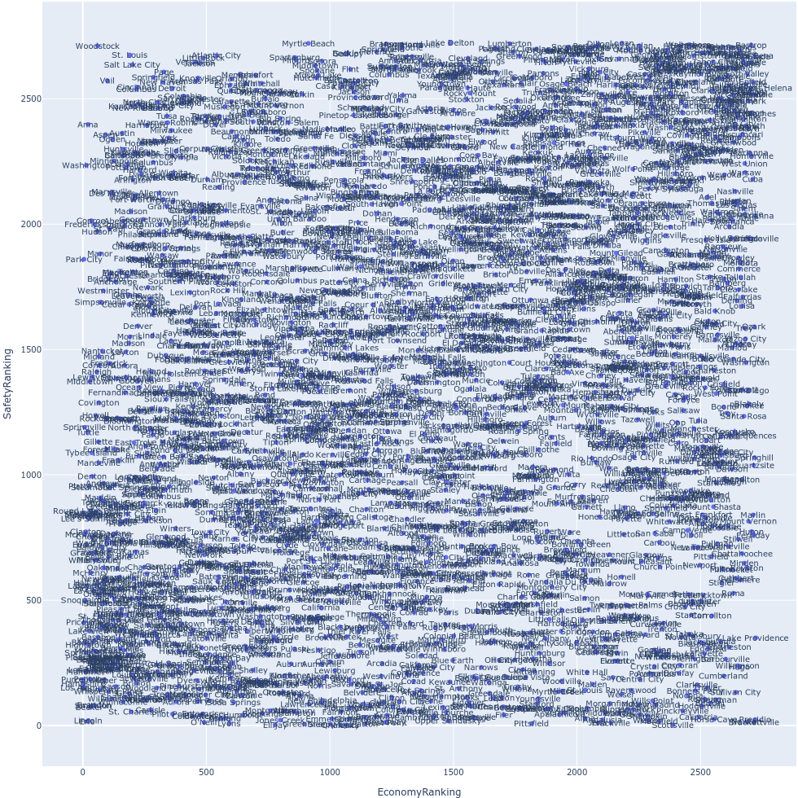

Slide 19
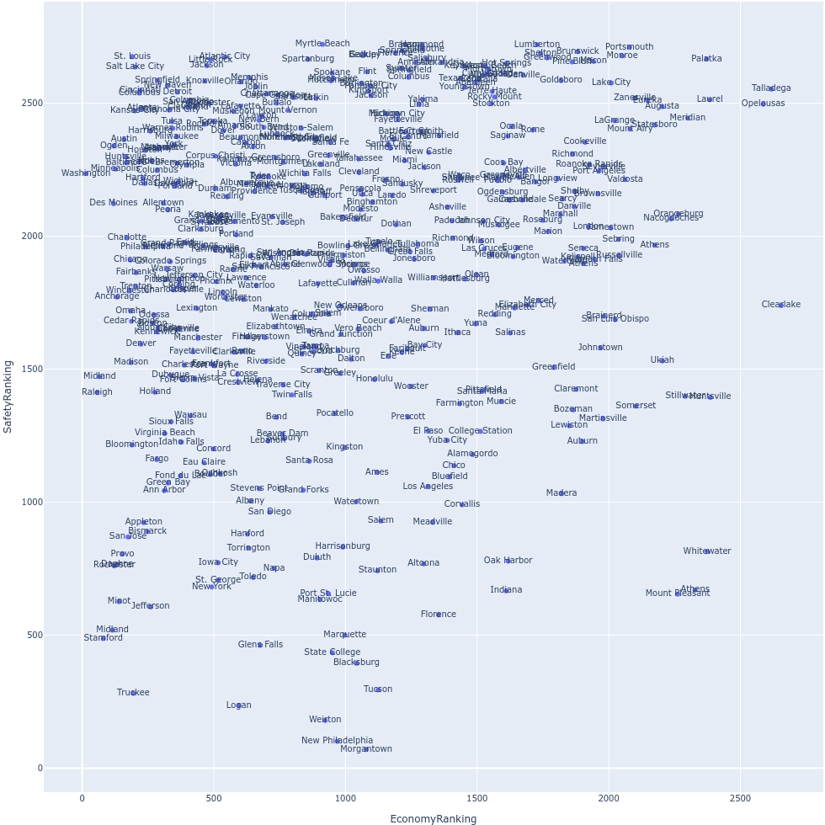
These are all cities that can be recommended. Rankings needed to be recalculated free from the influence of cities with an estimated COL.

Slide 20
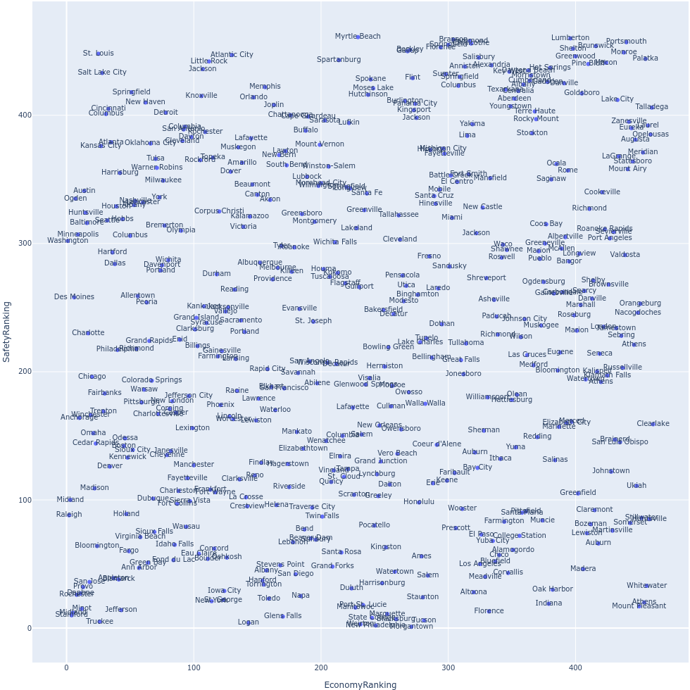
With rankings recalculated the top recommended cities change order slightly.

Slide 21
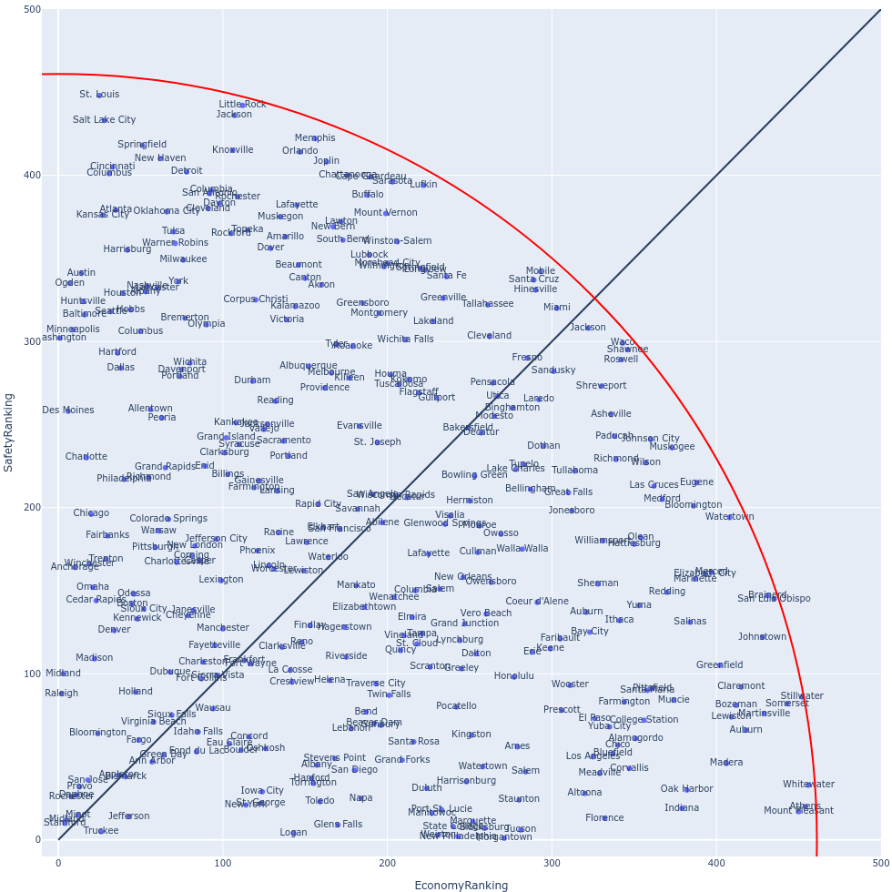
With Cities are divided into two categories, one skewing more economical and one skewing more to safer.
Cities that were beyond this red quarter circle were removed. The x and y bounds of the arc were the max economy and safety ranking. Cities have little semblance of balance between safety and economy beyond this point and are bad cities to recommend anyway. Cities beyond this arc have no chance of being the safest or the most economical.

Slide 22
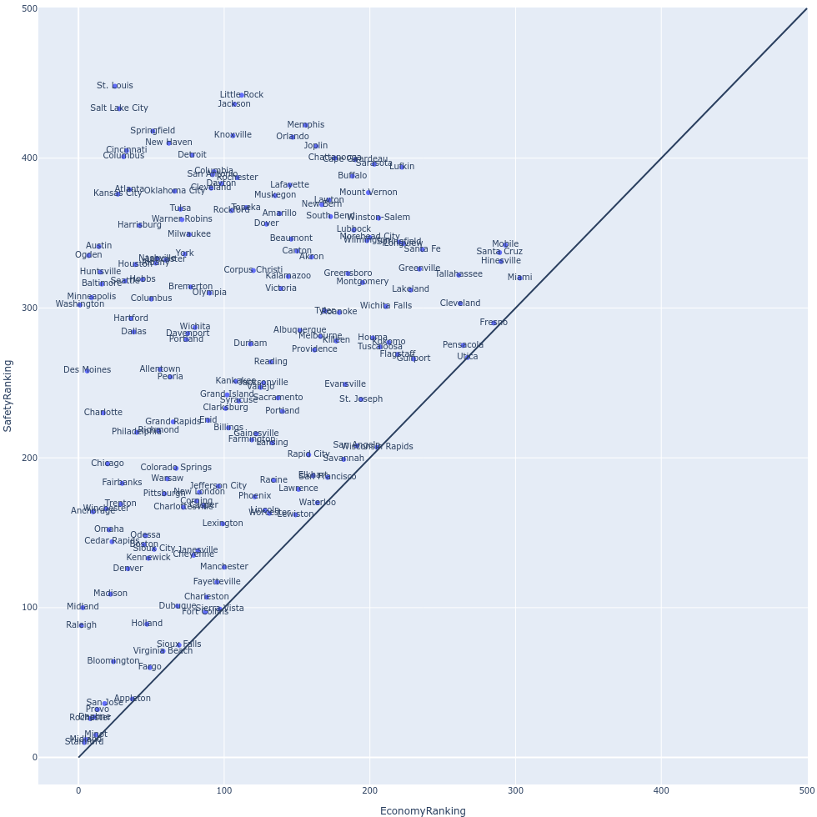
These are cities that skew more economical. Notice that economy rankings of cities don’t go much beyond 300.

Slide 23
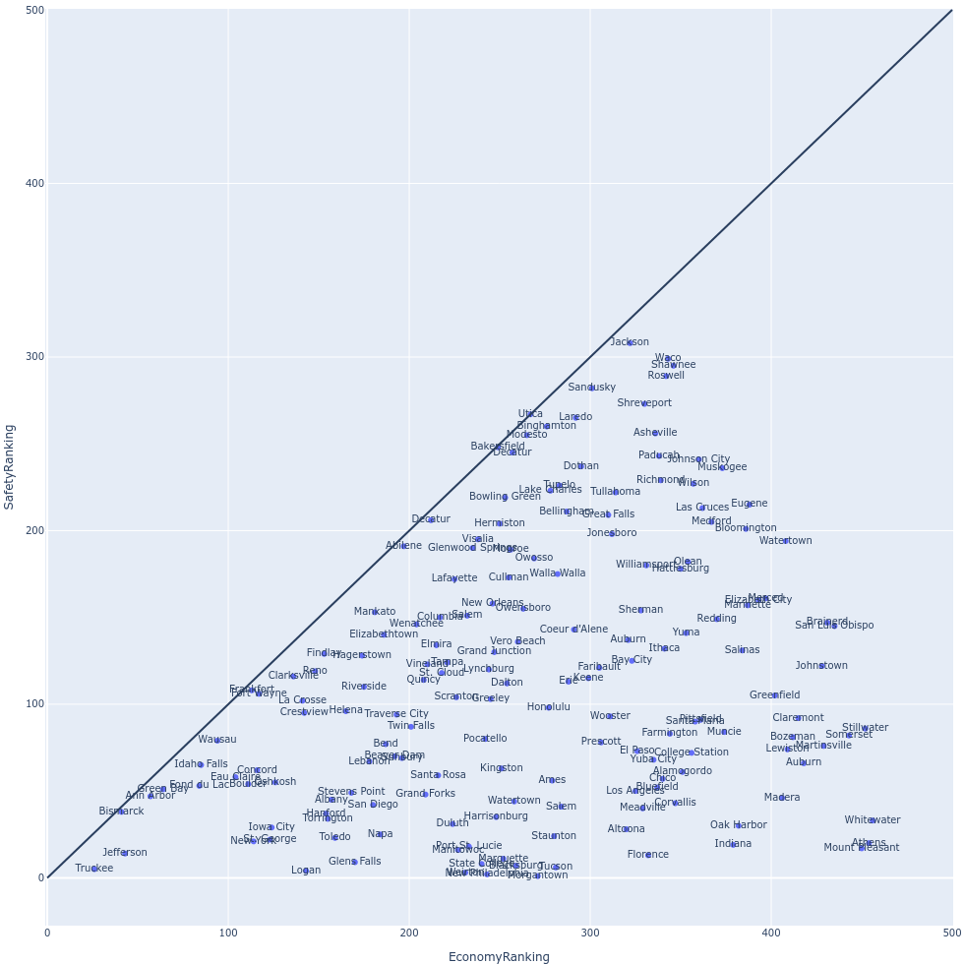
These are cities that skew more to safety. Notice that safety rankings of cities don’t go much beyond 300.

Slide 24
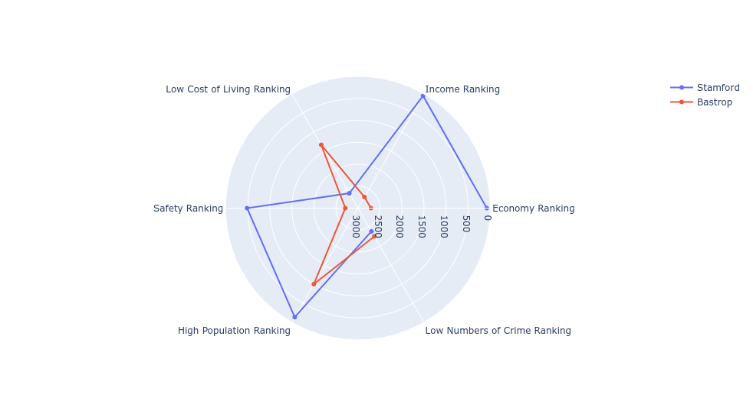
Bastrop has an estimated safety and economy below average compared to all cities.
Disclaimer: Cities are ranked from a pool of 2723 cities. The cost of living for most cities are estimated.
The Economy and Low Cost of Living Rankings can be misleading if two cities have Rankings very close to each other.
Crime Ranking and High Population Ranking are determined from an FBI dataset from 2010.

Slide 25
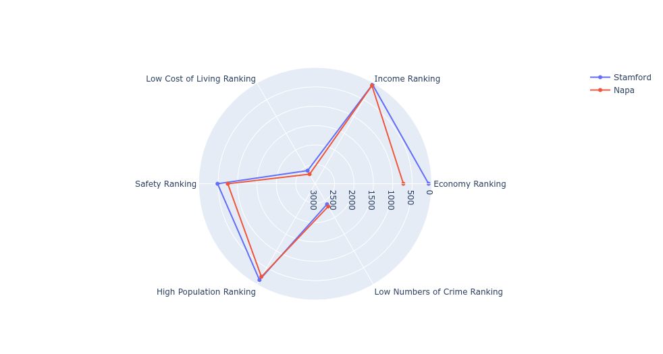
Napa has an estimated safety and economy above average compared to all cities.
Disclaimer: Cities are ranked from a pool of 2723 cities. The cost of living for most cities are estimated.
The Economy and Low Cost of Living Rankings can be misleading if two cities have Rankings very close to each other.
Crime Ranking and High Population Ranking are determined from an FBI dataset from 2010.

Slide 26
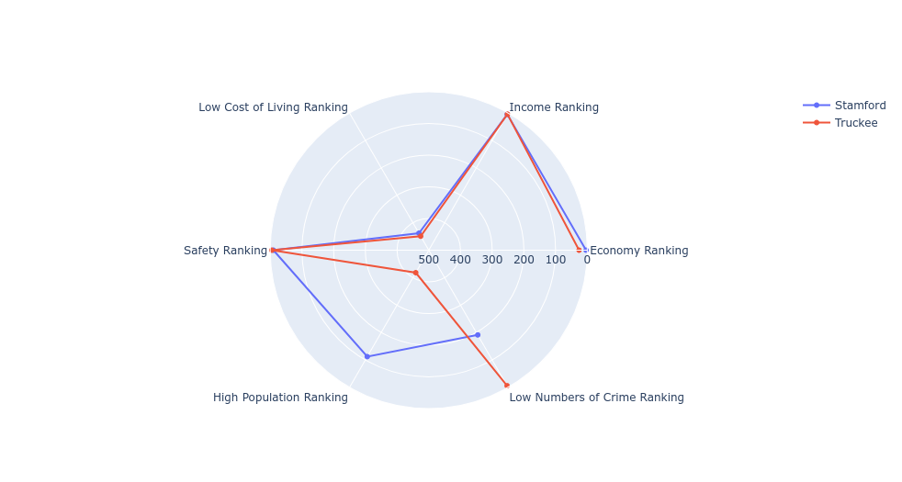
Stamford's economy is the best out of two.
Stamford is the most balanced between safety and economy out of two.
Truckee's safety is the best out of two.
Disclaimer: Cities are ranked from a pool of 461 cities. Cost Of Living is NOT estimated in any of these cities.
Crime Ranking and High Population Ranking are determined from an FBI dataset from 2010.

Slide 27
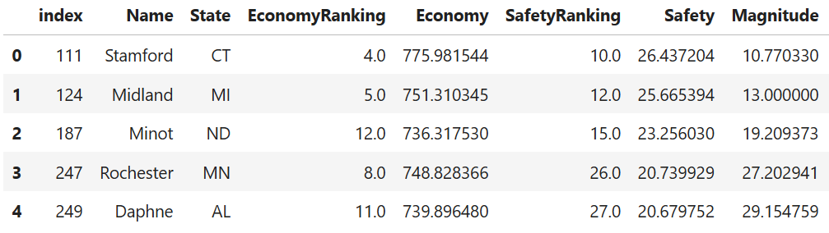
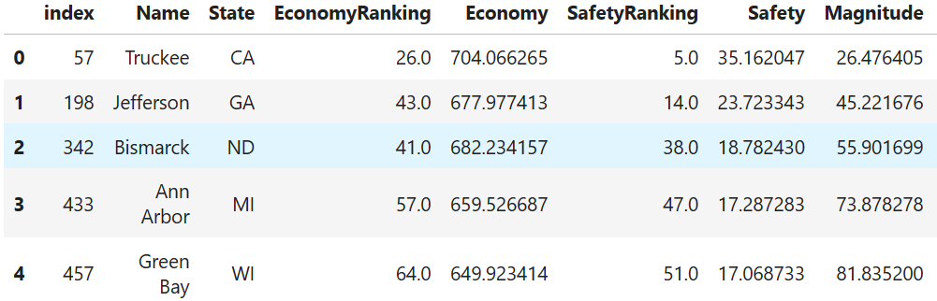
More economical cities
Safer cities

Slide 28
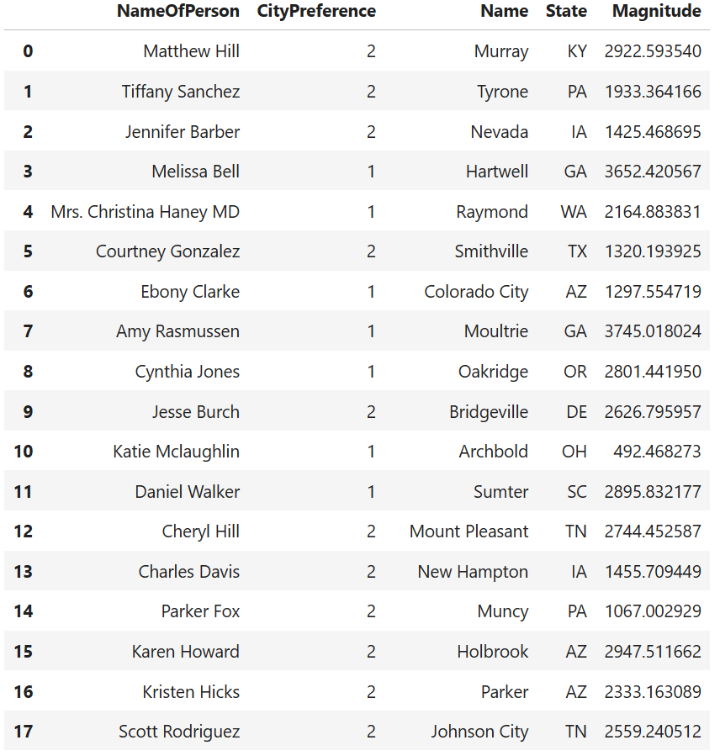
A fake list of 1000 people were randomly generated. They “lived” in cities that were mostly considered worse. These people also had a preference for either a safer or economical city.

Slide 29
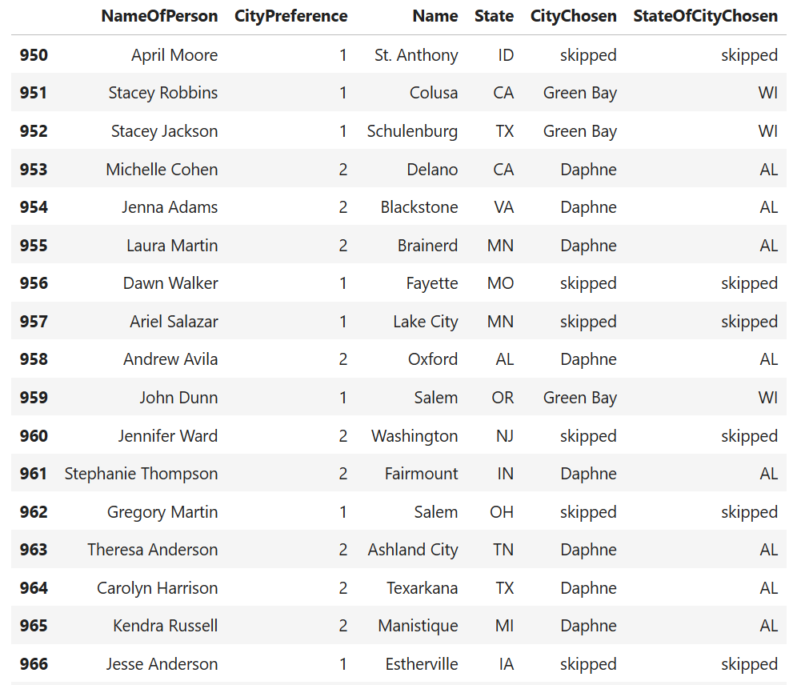
A simulation was run where people decided to relocate if the recommendation was significantly better than the city they already live in. The simulation was “first come first serve”, which arguably isn’t the fairest.
This image is part of the tail end of the list of people, where the top best cities were already filled up. As you can see, people decided to skip relocating.
To make the simulation fairer, people could be sorted where they live in estimated worse cities first, and people who live in worse cities would be given more priority.

